Slide 1






Spam email Detection
Student Details
Name:GANESH S
NM Id:aut5135LEEE001
College Name:AMCET

Slide 2
Disclaimer
The content is curated from online/offline resources and used for educational purpose only
Source :

Slide 3
Course Outline
Abstract
Problem Statement
Aims, Objective & Proposed System/Solution
System Deployment Approach
Model Development & Algorithm
Future Scope
Output of the Project
Conclusion
Reference

Slide 4
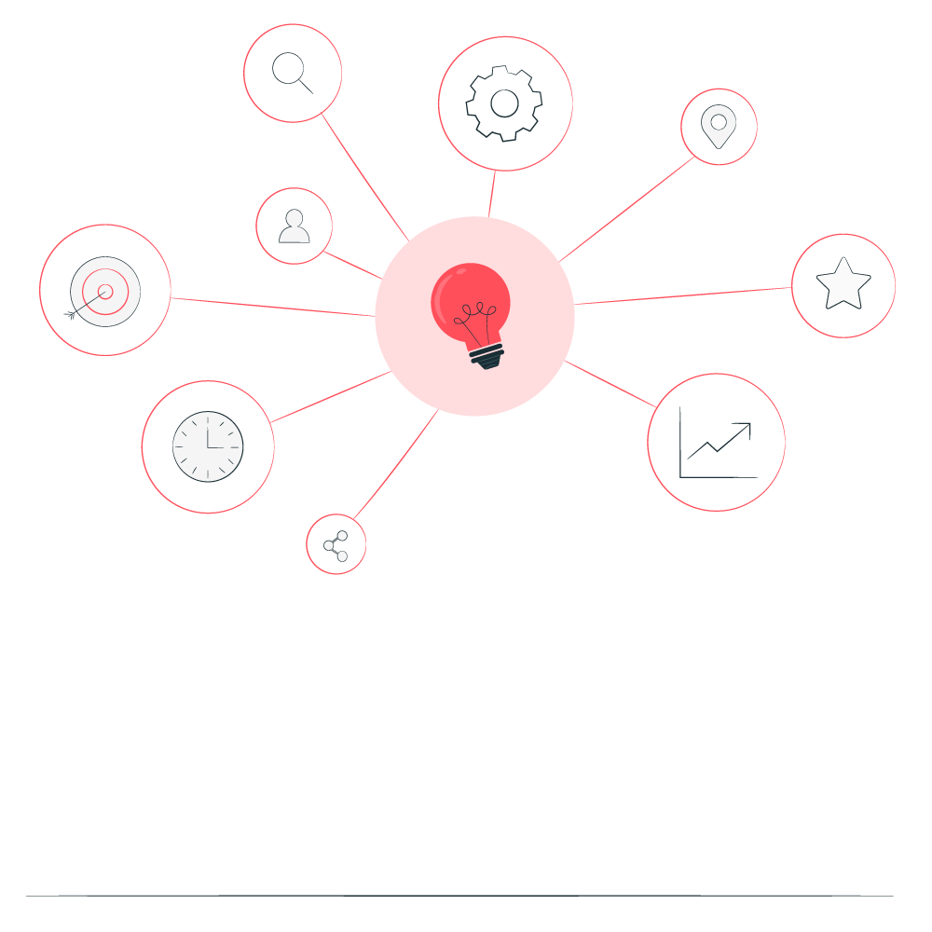

Abstract
Spam email detection is a crucial task in modern email communication systems to protect users from unsolicited and potentially harmful messages.
This paper presents an overview of various techniques and approaches employed in spam email detection, including rule-based filtering, machine learning algorithms, and deep learning models.
The challenges associated with spam detection, such as evolving spamming techniques and the balance between false positives and false negatives, are discussed.
Furthermore, we discuss recent advancements in spam detection, including the utilization of contextual information, behavioral analysis, and ensemble learning strategies.
Source :

Slide 5

The paper concludes with insights into future directions for enhancing spam email detection systems, including the integration of advanced NLP techniques and the development of robust models capable of handling dynamic spamming strategies.
Furthermore, recent advancements in spam detection leveraging natural language processing (NLP) and ensemble learning methods are explored.
Finally, we outline future research directions aimed at improving the efficacy and resilience of spam detection systems in the face of evolving spamming techniques and sophisticated attacks.

Slide 6

Problem Statement
High volume of spam emails overwhelms detection systems.
Spammers continually evolve tactics to evade detection.
Imbalance between spam and legitimate emails in datasets affects model training.
Balancing false positives (misclassifying legitimate emails) and false negatives (missing spam) is challenging.
Identifying relevant features from email content and metadata is difficult.
Source :

Slide 7

Identifying relevant features from email content and metadata is difficult.
Understanding contextual cues in email content requires advanced NLP.
Systems must adapt to new spam patterns without frequent updates.
Scalability is crucial to handle increasing email traffic efficiently.
Privacy concerns arise from inspecting email content for spam.
Choosing appropriate evaluation metrics to assess detection performance is important.
Real-time processing demands quick and accurate spam classification.

Slide 8

Aim & Objective
Aim: The aim of spam email detection is to accurately identify and filter out unsolicited and potentially harmful messages from users' email inboxes, while allowing legitimate emails to reach their intended recipients.
Protect users from spam-related threats like phishing and malware.
Enhance email productivity by reducing clutter.
Adapt to evolving spamming techniques.
Maintain a balance between accuracy and efficiency in filtering.
Source :

Slide 9
Objectives:
Maintaining the integrity and reputation of email service providers and organizations.
Safeguarding sensitive information and preventing identity theft or fraud facilitated through spam emails.
Providing transparent and user-friendly spam filtering mechanisms.
Educating users about potential spam threats and best practices for email security.
Enhancing the scalability and efficiency of spam detection systems to handle increasing email volumes.
Detecting and mitigating sophisticated spamming tactics, such as spoofing and social engineering.
Integrating with other security systems to create a layered defense against email-based threats.
Monitoring and analyzing email traffic to identify emerging spam patterns and trends.
Offering real-time protection against spam to minimize exposure to malicious content.
Collaborating with industry partners and researchers to exchange insights and improve spam detection capabilities collectively.
Source :

Slide 10

Protecting users from phishing attempts, malware distribution, and other malicious activities.
Providing users with customizable spam filtering options to suit their preferences.
Complying with relevant regulations and privacy standards governing email communication and spam prevention.
Continuously improving spam detection methods to stay ahead of emerging threats and ensure robust email security.
Source :

Slide 11

Proposed Solution
This involves analyzing the content of the email, including the subject line, body text, and attachments, to identify patterns or keywords commonly associated with spam emails.
This technique checks the reputation of the sender's email address or domain against blacklists or whitelists maintained by anti-spam organizations or services.
This is a statistical method that uses machine learning algorithms to classify emails as spam or legitimate based on the occurrence of certain words or patterns in the content.
This approach uses predefined rules and heuristics to identify characteristics commonly found in spam emails, such as excessive use of capitalization, excessive punctuation, or suspicious URLs.

Slide 12



This method leverages user feedback and reports from a community of users to identify and block spam emails more effectively.
These include methods like Sender Policy Framework (SPF), DomainKeys Identified Mail (DKIM), and Domain-based Message Authentication, Reporting, and Conformance (DMARC) to verify the legitimacy of the sender's email server and prevent spoofing.
This technique scans images and attachments for known spam patterns or potentially malicious content.
Many modern spam filters employ machine learning algorithms that can adapt and improve their spam detection capabilities over time based on user feedback and new spam patterns.

Slide 13
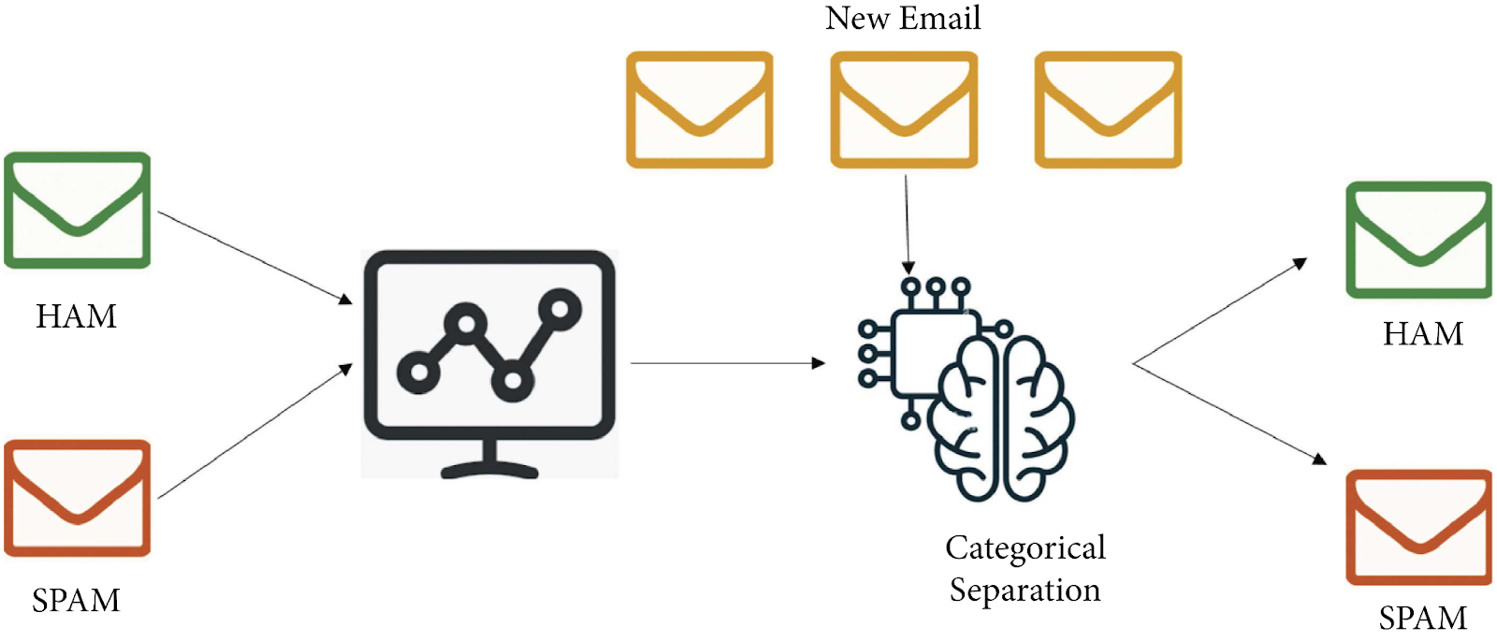
System Deployment Approach

Slide 14
Model Development & Algorithm
Data set description:
The dataset contains multiple emails in csv format.
Size of the dataset is 5500.
Categorized into Two classes.
Ham, Spam
Each classes contains more than 2500 mails
Source :

Slide 15
Model Development & Algorithm
Email Receiving: The email server or client receives incoming emails from various sources.
Pre-processing: The email content is prepared for analysis by performing tasks such as:
Decoding and parsing the email headers, body, and attachments
Removing HTML tags, scripts, and other markup elements
Converting the email body to plain text
Normalizing text (e.g., converting to lowercase, removing punctuation)
Feature Extraction: Relevant features are extracted from the email content, including:
Word and phrase frequencies
Presence of specific keywords or patterns
Sender information
Email headers
URLs and link properties
Image and attachment properties

Slide 16
Feature Selection: Irrelevant or redundant features may be removed to improve model performance and reduce computational complexity.
Model Application: The pre-processed email and extracted features are passed through the trained spam detection model(s), which can be based on techniques such as:
Naïve Bayes classifiers
Support Vector Machines (SVMs)
Decision Trees and Random Forests
Logistic Regression
Neural Networks and Deep Learning
Classification: The model(s) classify the email as either spam or legitimate (ham) based on the learned patterns and decision boundaries.

Slide 17
Scoring and Thresholding: Some models provide a probability or confidence score for the spam classification. A threshold can be set to determine the minimum score required to classify an email as spam.
Post-processing and Action: Based on the classification result, appropriate actions can be taken, such as:
Moving spam emails to a designated spam folder
Rejecting or quarantining spam emails
Applying additional security measures
Allowing legitimate emails to reach the user's inbox
User Feedback: Many spam detection systems allow users to provide feedback on misclassified emails, which can be used to improve the model's accuracy over time.
Model Updates and Retraining: As new spam patterns emerge or user feedback is collected, the spam detection models may need to be updated or retrained periodically to maintain high accuracy.

Slide 18
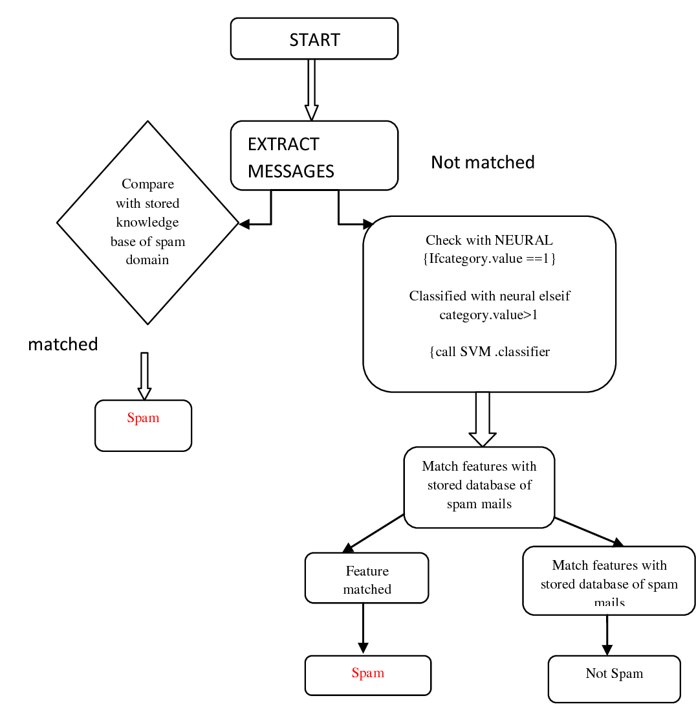
Model Development & Algorithm
Flow chart

Slide 19
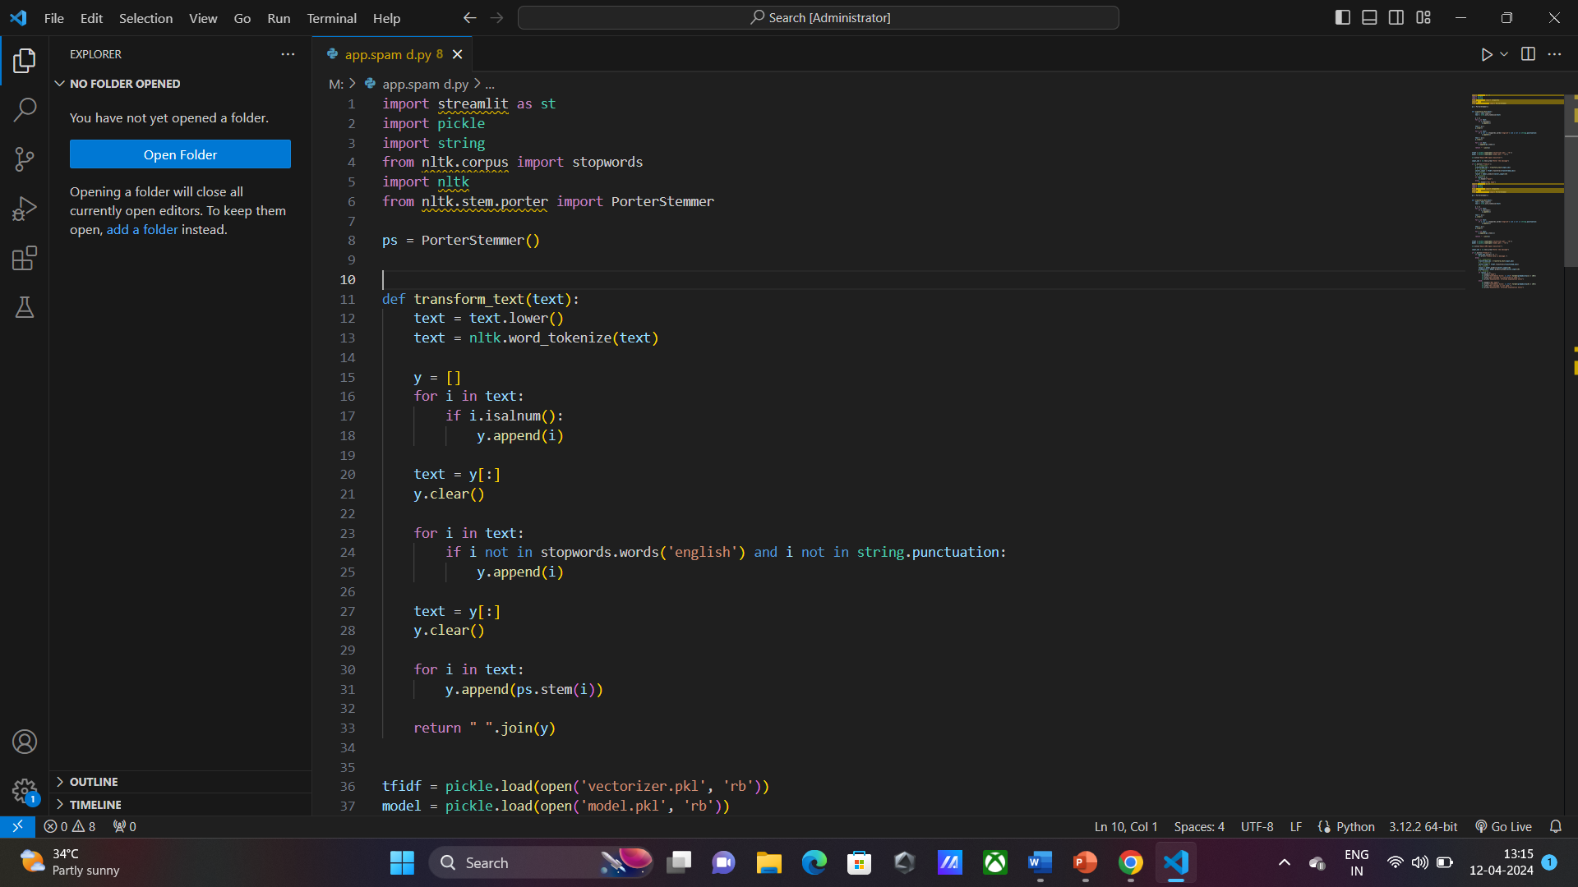
working:

Slide 20
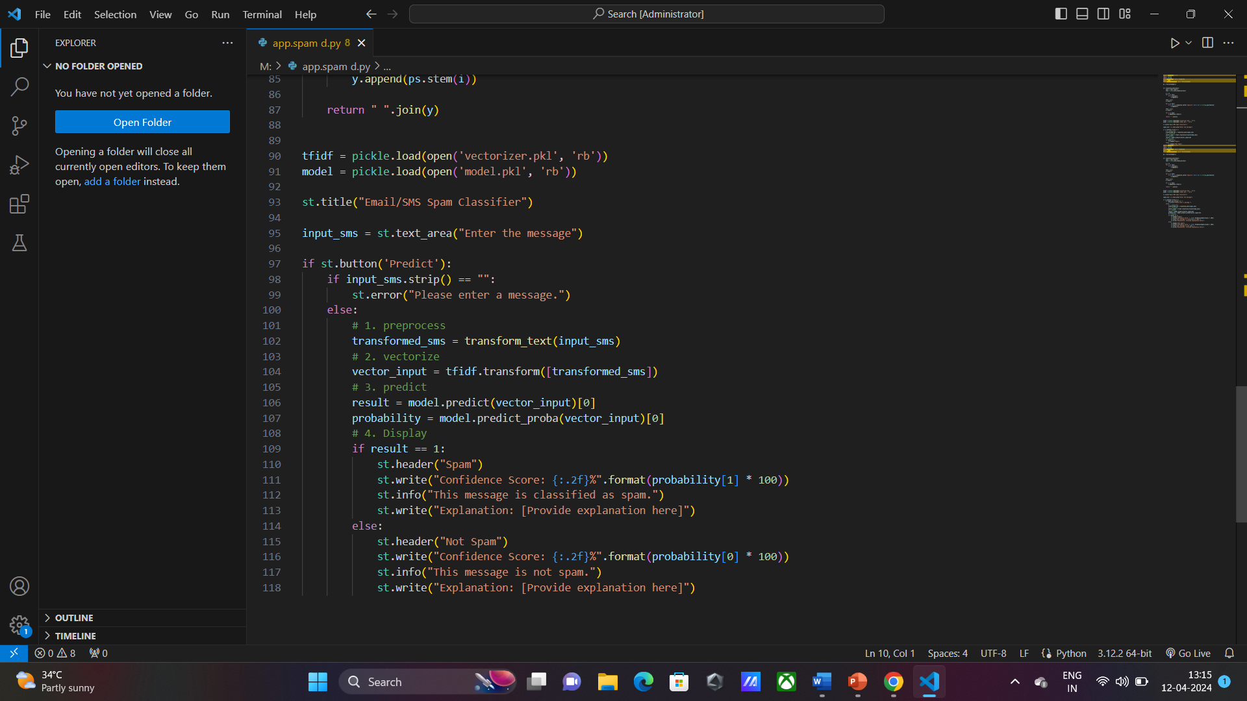

Slide 21
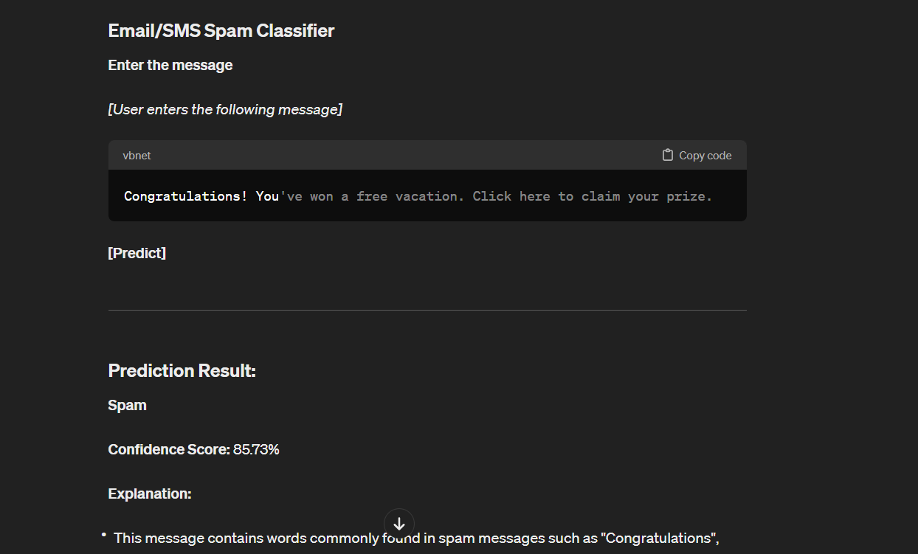
RESULT:

Slide 22
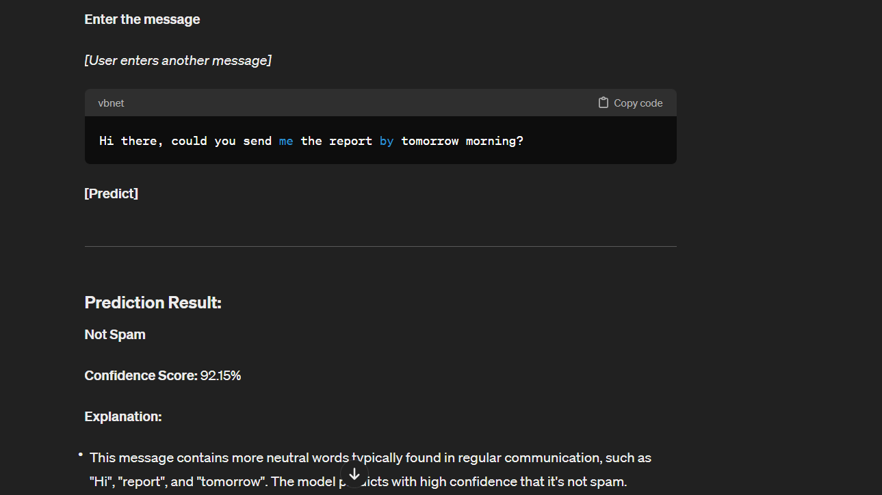
RESULT:

Slide 23
Future Enhancements:
Deep Learning Architectures: Experiment with more advanced deep learning architectures like recurrent neural networks (RNNs), long short-term memory networks (LSTMs), or transformers. These models might capture more intricate patterns and dependencies in email content.
Adversarial Training: Train the model against adversarial examples generated specifically to evade spam detection. This could improve the model's robustness against sophisticated spamming techniques.
Multi-Modal Learning: Incorporate not only the email text but also metadata, attachments, and sender information into the model. Multi-modal learning can provide a more comprehensive understanding of the email content and context.
Active Learning: Implement active learning techniques to iteratively improve the classifier by selecting the most informative emails for manual labeling. This approach can help maximize the effectiveness of the classifier with minimal human effort

Slide 24
Conclusion
In conclusion, spam email classification remains an ongoing challenge in the realm of cybersecurity and email filtering. Despite advancements in machine learning and natural language processing, the battle against spam continues as spammers develop increasingly sophisticated techniques to evade detection.
Future enhancements in spam email classification are likely to focus on leveraging deep learning models, ensemble methods, and adversarial training to create more robust classifiers. Feature engineering, active learning, semi-supervised learning, and cross-domain learning are also promising avenues for improving classification accuracy and generalization.
Source :

Slide 25
THANK YOU
Notes:
Thank You !!

